Slide 1
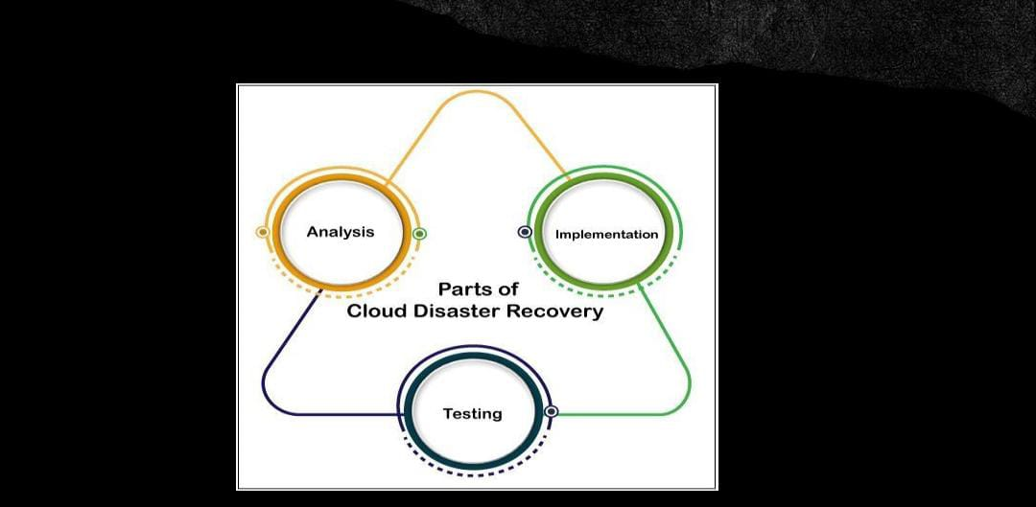


Slide 2
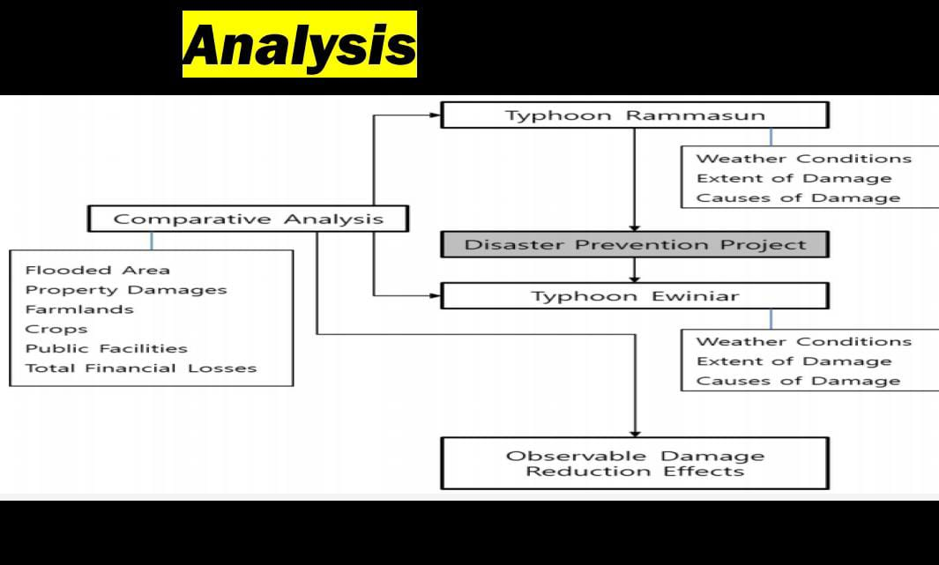

Slide 3


Slide 4
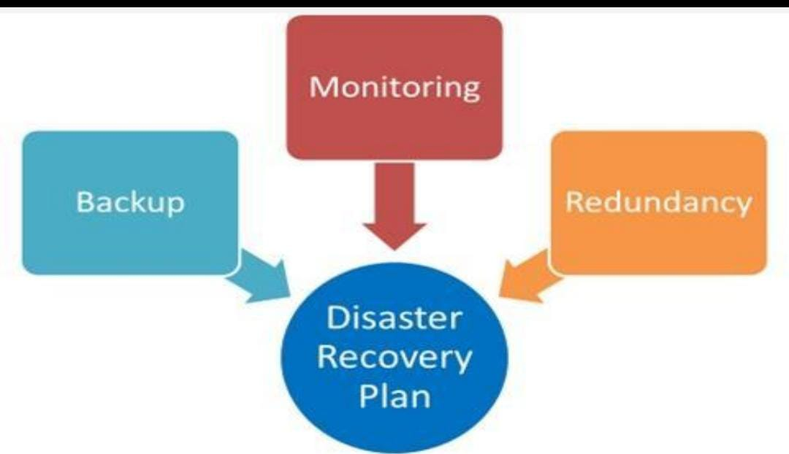

Slide 5


Slide 6


Slide 7


Slide 8
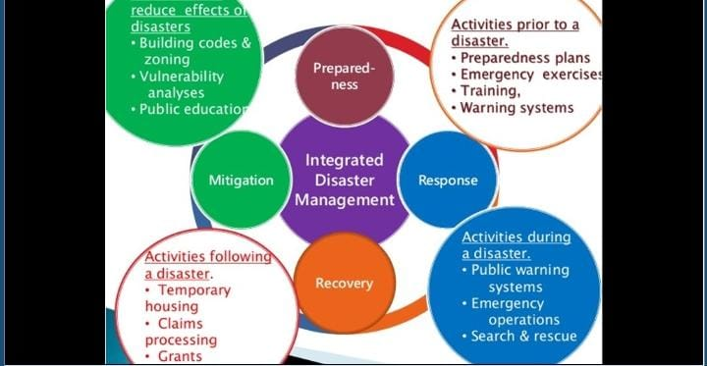

Slide 9
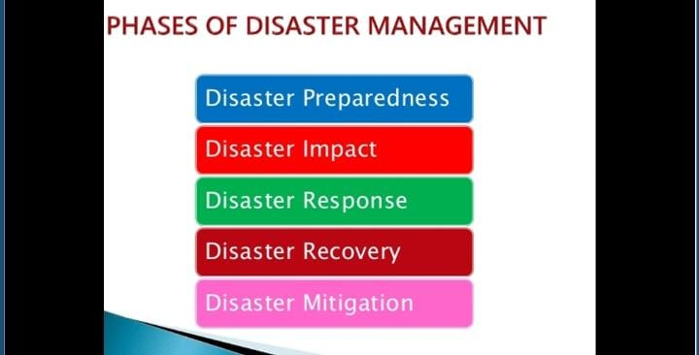

Slide 10
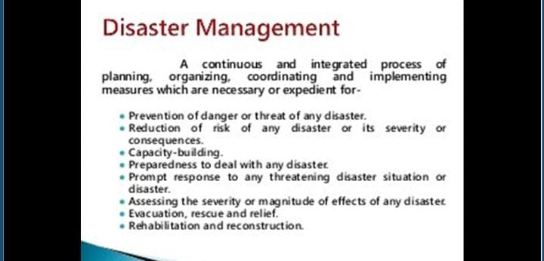

Slide 11


Slide 12
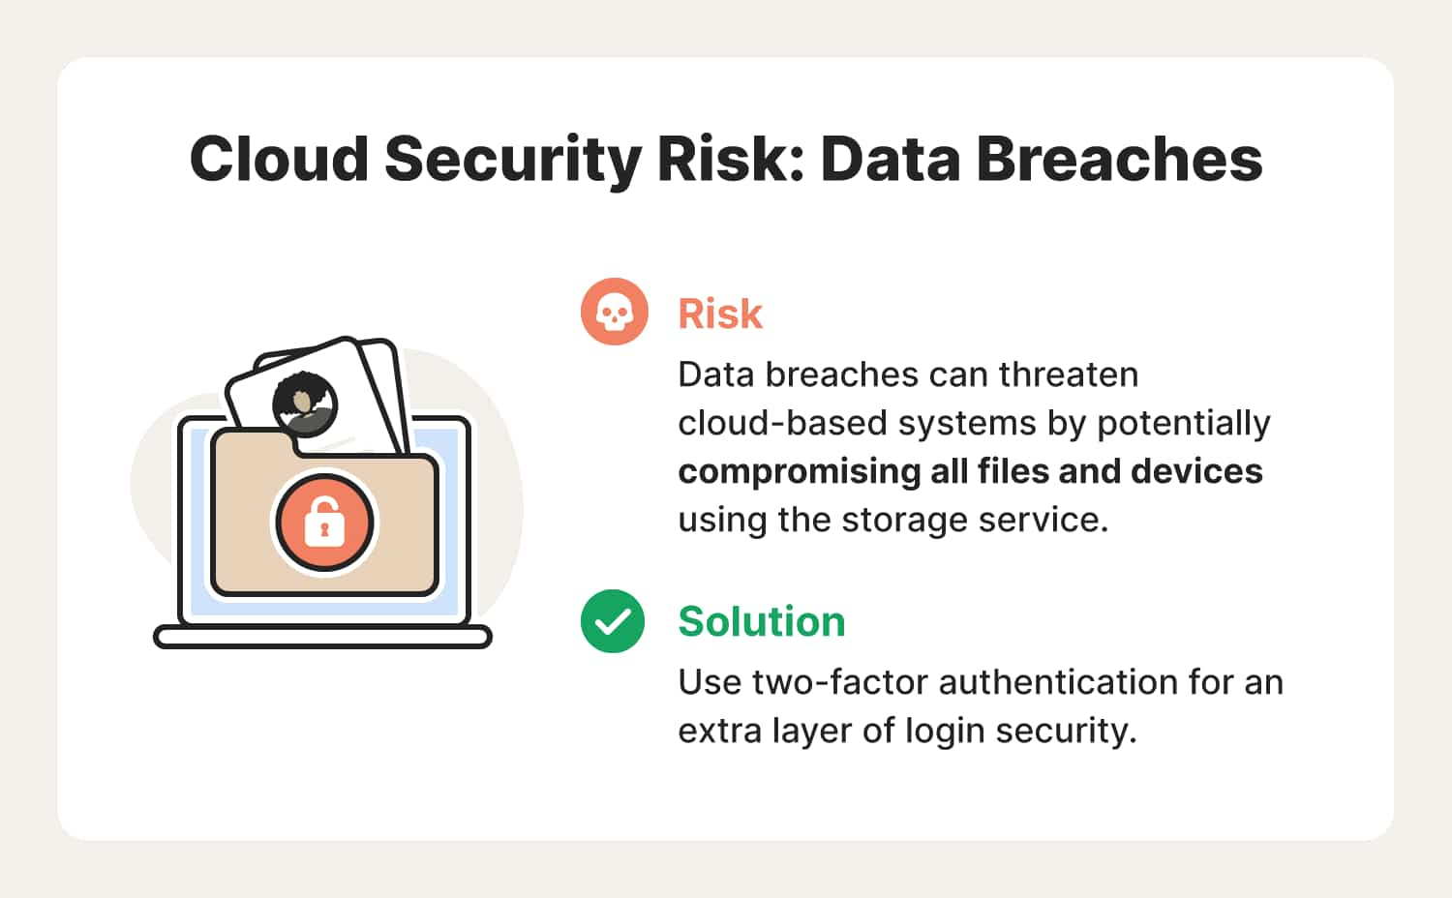

Slide 13
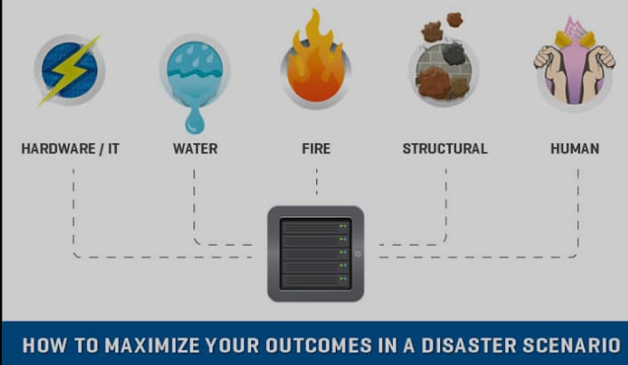

Slide 14


Slide 15
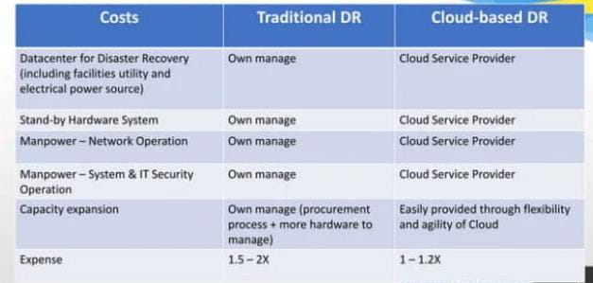

Slide 16
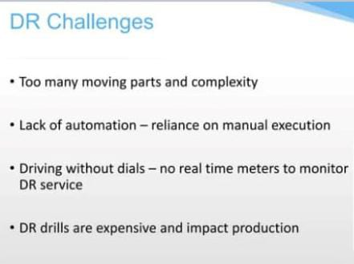

Slide 17


Slide 18
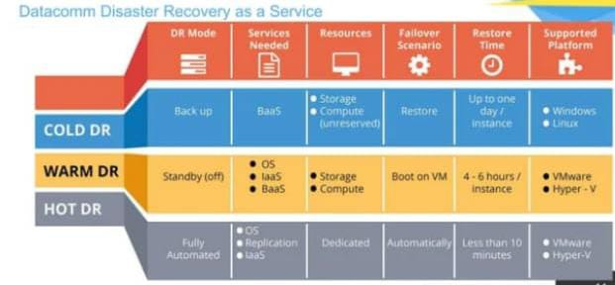

Slide 19


Slide 20
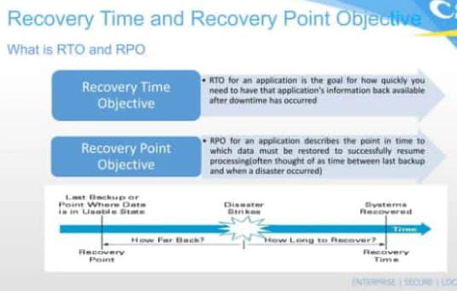

Slide 21
Program for disaster recovery management
#include <stdio.h>#include <stdlib.h>#include <string.h>#include <time.h>int main() { // Get the current date and time time_t rawtime; struct tm *timeinfo; char timestamp[80]; time(&rawtime); timeinfo = localtime(&rawtime); strftime(timestamp, sizeof(timestamp), "%Y-%m-%d_%H-%M-%S", timeinfo); // Set up paths for source and backup directories char sourceDir[] = "/path/to/source_data"; char backupDir[255]; snprintf(backupDir, sizeof(backupDir), "/path/to/backup_data/backup_%s", timestamp); // Create the backup directory if (mkdir(backupDir, 0777) == 0) { printf("Backup directory created: %s\n", backupDir); // Copy data from source to backup char command[255]; snprintf(command, sizeof(command), "cp -r %s %s", sourceDir, backupDir); if (system(command) == 0) { printf("Backup successful.\n"); } else { printf("Backup failed.\n"); } } else { printf("Failed to create backup directory.\n"); } return 0;}
Notes:
#include <stdio.h>#include <stdlib.h>#include <string.h>#include <time.h>int main() { // Get the current date and time time_t rawtime; struct tm *timeinfo; char timestamp[80]; time(&rawtime); timeinfo = localtime(&rawtime); strftime(timestamp, sizeof(timestamp), "%Y-%m-%d_%H-%M-%S", timeinfo); // Set up paths for source and backup directories char sourceDir[] = "/path/to/source_data"; char backupDir[255]; snprintf(backupDir, sizeof(backupDir), "/path/to/backup_data/backup_%s", timestamp); // Create the backup directory if (mkdir(backupDir, 0777) == 0) { printf("Backup directory created: %s\n", backupDir); // Copy data from source to backup char command[255]; snprintf(command, sizeof(command), "cp -r %s %s", sourceDir, backupDir); if (system(command) == 0) { printf("Backup successful.\n"); } else { printf("Backup failed.\n"); } } else { printf("Failed to create backup directory.\n"); } return 0;}

